Slide 1
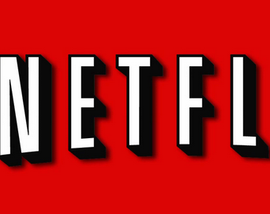
Capstone Project: Netflix Data
Visualize Netflix data using Python

Slide 2

Content
Visualizing the Netflix quarterly data by violinplot
Chart the performance of the earnings per share (EPS)
Visualize the earnings and revenue reported by Netflix
Compare Netflix stock to the Dow Jones Industrial Average in 2017

Slide 3
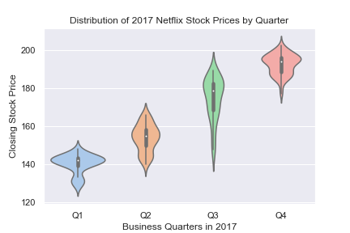
By the graphics, we can tell that Netflix Stock prices was growing up. However prices in third quarter did most fall throughout the year. The minimum stock price is about 120 and the maximum higher than 200.

Slide 4
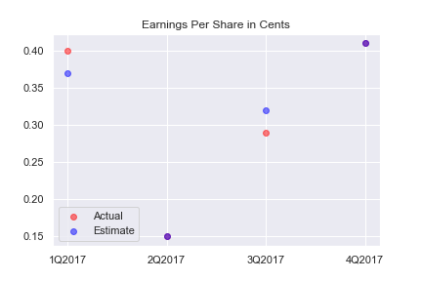
By the graphics, we can tell that estimated values was very accurate. Moreover in 2Q2017 and in 4Q2017 actual values and estimated values were equal

Slide 5
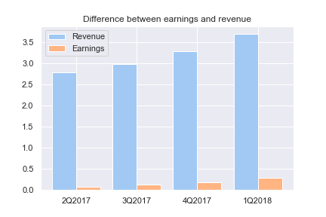
Revenue followed a trend, while earnings didn’t. Earnings is only 0.02% of actual revenue

Slide 6
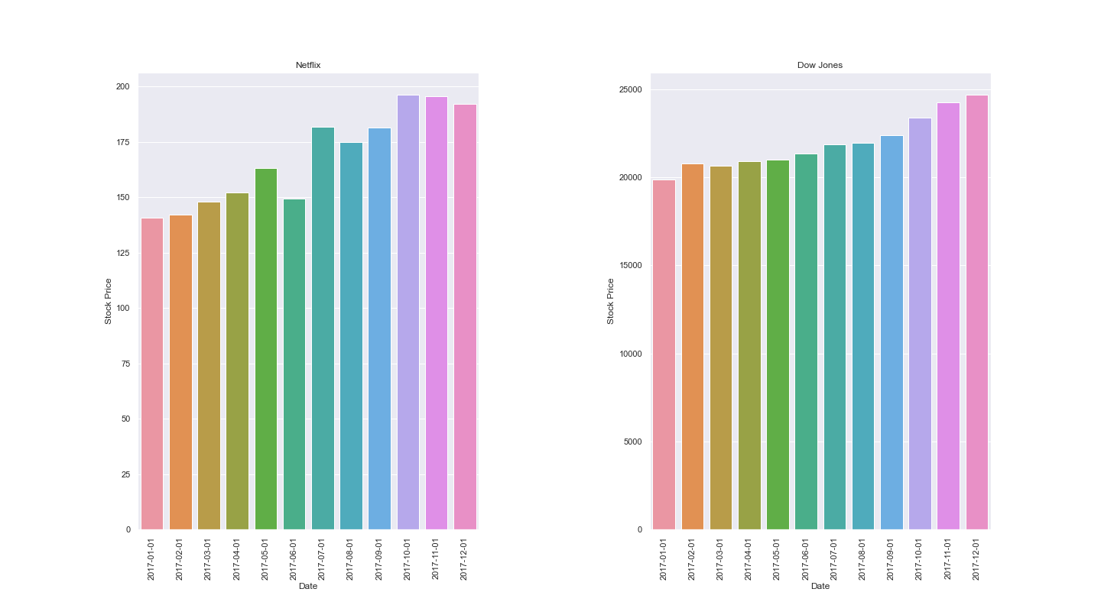
As we can see by this two bar plots, Netflix stock price dynamic was volatile, while Dow Jones’s was stable growing. In addition Netflix stock final price was much lesser than Dow Jones’s

Slide 7
Thank you for your attention

